Slide 1
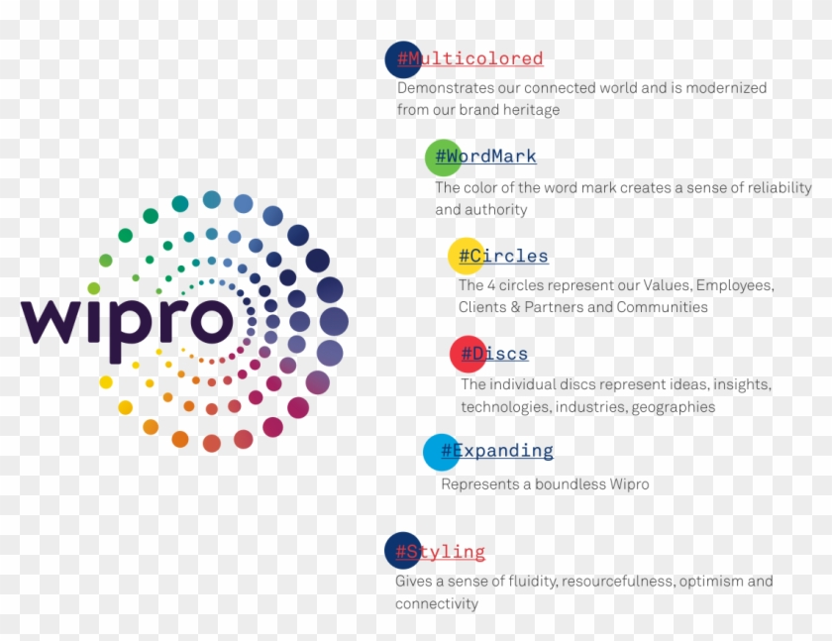

Slide 2
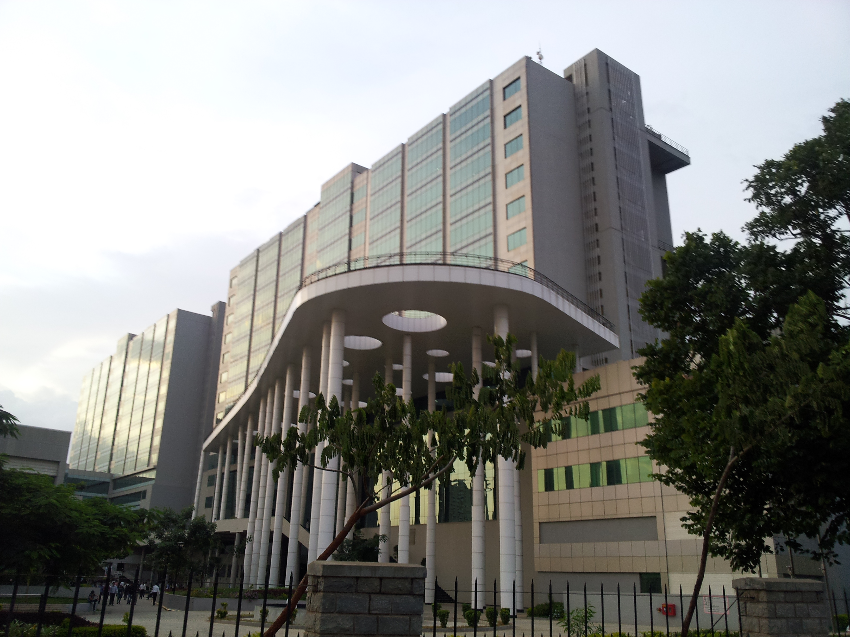






WIPRO
FOUNDED :
29 DECEMBER 1945 , 76 YEARS AGO …..
Wipro Limiteds an Indian multinational company that provides information technology consulting and business prosess services. Thierry Delaporte is serving as CEO and managing director of Wipro from July 2020.It is headquartered in bangalore karnataka, India. Wipro's capabilities range across Cloud computering, cyber security, digital transformation, artificial inteligence, robotics,data analytics, and other technology consulting services to customers in 67 countries. The company was incorporated on 29 December 1945 in amalner,India, by Mohamed Premji as Western India Vegetable Products Limited, later abbreviated to Wipro. In 1966, after Mohamed Premji's death, his son Azim Premji took over Wipro as its chairman at the age of 21. IIn 1982, the name was changed again, from Wipro Products Limited to Wipro Limited. Wipro has committed to achieving Net Zero emissions by 2040, with an intermittent goal of reducing emissions 55% by 2030. In October 2021, Wipro's Net Zero plans were certified by the Science-based Targets Initiative.

Slide 3

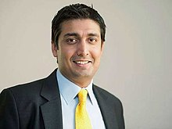
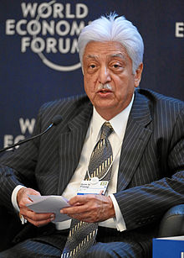
CEO
Chairman
Owner
Thierry Delaporte
Rishad Premji
Azim Hashim Premji

Slide 4



W I P R O
WORKS ALL OVER THE INDIA
Harayana
New delhi
Rajasthan
Gurgaon
Uttarpradesh
Guwahati
Gujarat
kolkata
Pune
Bhuwaneshwar
Mumbai
Hyderabad
Bangaluru
Visakhapatnam
Mysuru
Chennai
TamilNadu
Kochi

Slide 5
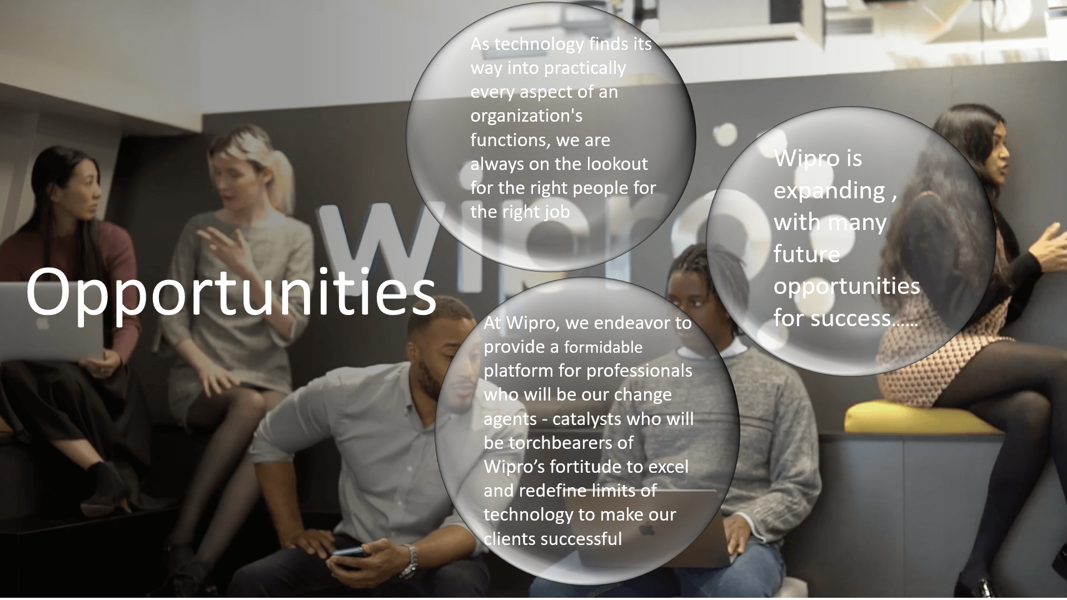

Slide 6

Low cost advantage and High quality standards
strength
Broad range of research and development Services
Wipro has impressive list of clientele and mega partnership with – Cisco, Oracle, EMC, Microsoft and SAP
One of the top IT Companies in India employing over 130,000 employees
Low operating margin of other group of companies
Weekness
Free floating stock is very less for the investor

Slide 7
Slowdown in US economy as major client base is from US
Attrition and Employee loyalty
Threats
Increasing cost of Human capital

Slide 8
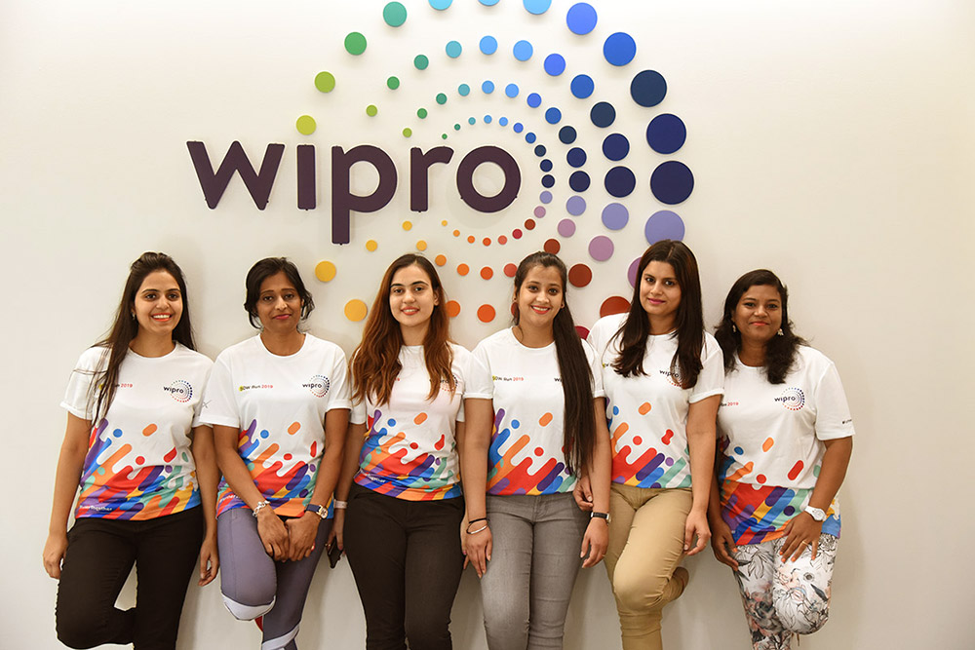
Contribution on social service
Educational CSR Activities And Initiatives By Wipro:
Wipro is a firm believer of the fact that education is the most significant enabler of social change a gateway for a better society. Over the years, they have partnered with a vast network of 118 educational organizations in India
Every Child Counts Campaign, Pune – The campaign runs on the agenda of enrolling children in the age group of 6 to 7 in schools in Pune. An NGO working for the education of children of marginalized communities at construction sites for over 20 years, Door Step School, noticed that there’s a large number of children who were out of school. Them, along with Wipro Cares came up wit
Save the Planet – TIST Program aims to empower and educate farmers across countries such as Uganda, Tanzania, Kenya, India, Honduras and Nicaragua. TIST India takes care of the TIST program in India. Along with Wipro Cares, TIST India encourages farmers to plant 25000 trees in their own land. This initiative also trains the farmers about activities to use their property more productively and efficiently.

Slide 9
KUMUD DNYANESHWAR METKAR
BBA(CA)FY
kumudmetkar99@gmail.com

